Slide 1
MOBILE APPLICATION DEVELOPMENT DROPBOX CLIENT Presented by group 2
Nguyễn Huy Hùng BI10-071
Hoàng Hữu Huy BI10-077
Nguyễn Hoàng Nam BI10-123
Lý Anh Kiệt BI10-092
Lương Nguyễn Việt Sơn BI10-156

Slide 2

INTRODUCTION
What is Dropbox ?
Founded in 2007 by MIT students Drew Houston and Arash Ferdowsi
A file hosting service
Operated by the American company Dropbox, Inc., headquartered in San Francisco, California
Offers cloud storage, file synchronization, personal cloud, and client software

Slide 3
ACTIVITIES

Slide 4
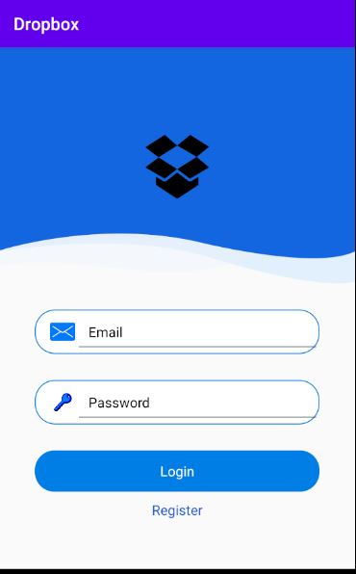
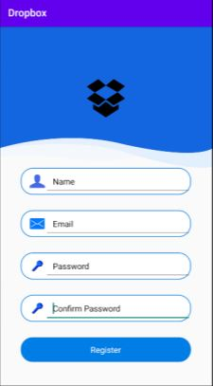
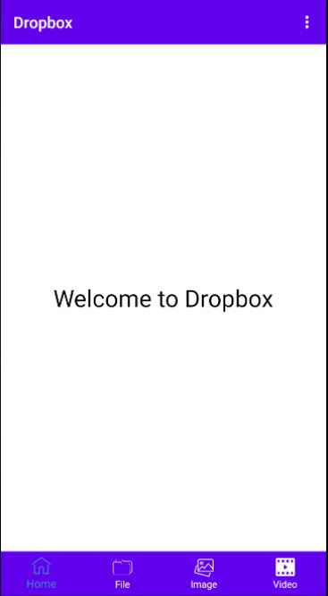
LOG IN SCREEN
Require Email and Password
Register
Login

Slide 5
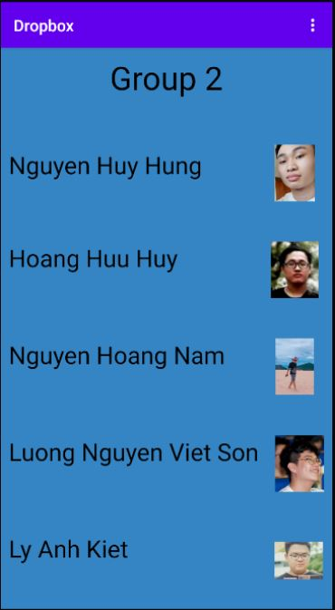
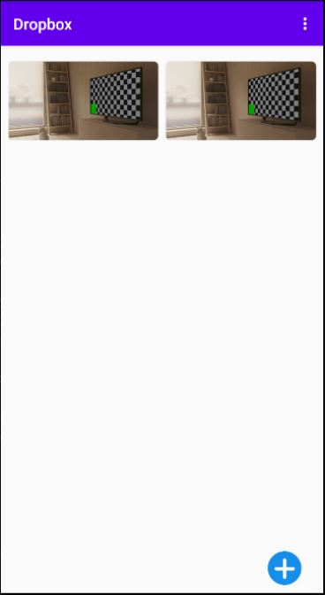
HOME SCREEN
About Us
Add Image
Log out

Slide 6
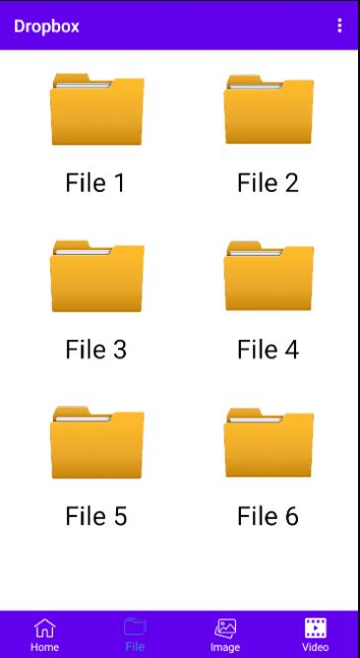
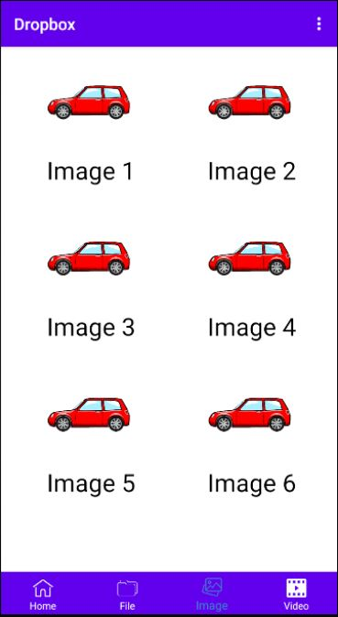
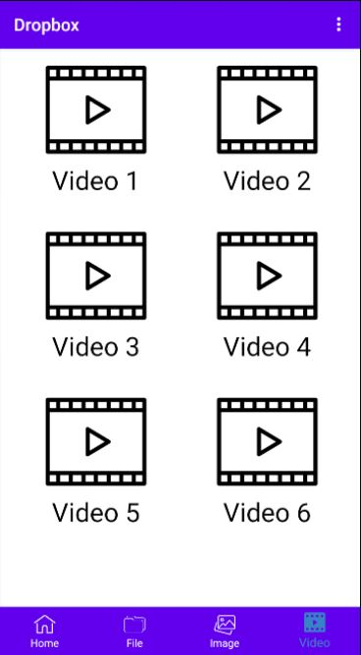
FILE, IMAGE AND VIDEO
FILE
IMAGE
VIDEO

Slide 7

VIEWPAGER Just SWIPE

Slide 8
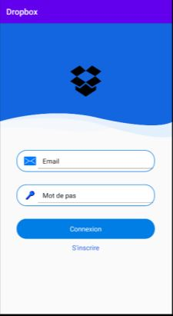

STRINGS
Using to translate to different languages
ENGLISH
FRENCH

Slide 9
DEMO

